Slide 1
Under and Over Expansion
AE 2010:
Thermodynamics and Fluids Fundamentals

Slide 2
Under/Over Expanded Nozzles
A_{e}
Recall previous analysis of CD nozzles, e.g., as back pressure is reduced
Have looked at range of P_{b} that produce
  Isentropic solutions or
  Shocks in nozzle
What happens when
  P_{b} < P_{es,sup} (U)
  P_{es,sup}< P_{b}< P_{e,sh} (O)
A_{t}
p_{o}
T_{o}
p_{e}
p_{b}
M
M_{es,sup}
1
M_{e,sh}
M_{es,sub}
p/p_{o}
x
1
M<1, isen.
p_{es,sub}
p*/p_{o}
M<1, shock
p_{e,sh}
O
p_{es,sup}
U
x

Slide 3
Under Expanded Nozzles
Start with P_{b}<P_{es,sub}
  Under expanded case
  P_{e}>P_{b} (not enough expansion has occurred)
So boundary condition at exit requires a supersonic expansion process
  2-D Prandtl-Meyer flow
  Flow turns, pressure drops to back pressure
  But flow must not cross centerline (symmetry line; like a wall)
p/p_{o}
1
M<1, isen.
p_{es,sub}
p*/p_{o}
M<1, shock
p_{e,sh}
p_{es,sup}
U
x
C
L
p₁=p_{e}
p₂=p_{b}
p_{b}

Slide 4
Centerline Boundary Condition
nonsimple region
Centerline
  Flow along centerline must be parallel to centerline
2
1
3
C
L
p₁>p_{b}
p₃<p_{b}
p₂=p_{b}
  To get flow to turn inward again requires another PM expansion
  But second expansion means pressure in region 3 drops below back pressure (P₃<P₂=P_{b})
  So now we will need to do something to match our pressure boundary condition at the edge of the jet
p_{b}

Slide 5
Jet Boundary Condition
Jet boundary
  Along “edge” of jet must satisfy pressure B.C.
slip line
2
3
4
1
5
C
L
p₁>p_{b}
p₅>p_{b}
p₃<p_{b}
p₂=p_{b}
p₄=p_{b}
p_{b}
  To match pressure, P must rise → compression
  Can get PM compression waves
  Combine to form oblique shocks, turn flow inward
  Centerline (velocity) boundary condition requires reflected compression waves
  Now pressure exceeds surrounding pressure (P₅>P_{b}), away we started, so process/cycle repeats itself

Slide 6
Under Expanded Jet
2
3
4
1
5
C
L
p₁>p_{b}
p₅>p_{b}
p₃<p_{b}
p₂=p_{b}
p₄=p_{b}
For P_{e}>P_{b}, nozzle produces a jet flow consisting of regions of decreasing and increasing P (or density)
  Inviscid flow (ideal), process would continue endlessly
  Viscous case (real), viscous losses and turbulent mixing with surroundings causes wave pattern to decay after small number of cycles

Slide 7
Over Expanded Nozzles
P_{es,sup}<P_{b}<P_{e,sh}
  Over expanded case
  Too much expansion has occurred
So boundary condition at exit requires a supersonic compression process
  Oblique shock (2-D)
  Flow turns, pressure rises to back pressure
  Flow must not cross centerline, so get reflected shocks
  Then expansion to match P, etc.
p/p_{o}
1
M<1, isen.
p_{es,sub}
p*/p_{o}
M<1, shock
p_{e,sh}
O
p_{es,sup}
x
C
L
p₁<p_{b}
p₃>p_{b}
p₂=p_{b}
p_{b}

Slide 8
Over Expanded Jet
2
4
1
3
5
C
L
p₁<p_{b}
p₅<p_{b}
p₃>p_{b}
p₂=p_{b}
p₄=p_{b}
For P_{e}<P_{b}, nozzle produces jet flow consisting of regions of increasing and decreasing pressure (or density)
  Same pattern as for under expanded case, just “out-of-phase” (compressions first, then expansions for over expanded vs. expansions then compressions for under expanded)

Slide 9
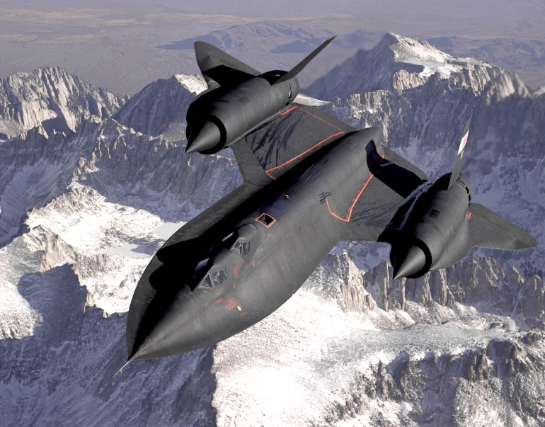
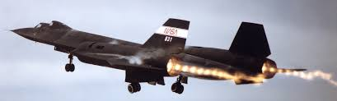

Mach (Shock) Diamonds
Regions of high pressure, also have high density (and temperature)
  These hot, dense gases emit light (radiation)
4
2
3
1
5
C
L
p₁>p_{b}
p₅>p_{b}
p₃<p_{b}
p₂=p_{b}
p₄=p_{b}

